Slide 1

Emotion Recognition using various methods
Mohaned Atef
Mohamed Walid
Marwan Khaled
Marwan Yasser
Reham Galal

Slide 2


Agenda
Introduction
Emotion recognition
Methods
Applications
conclusion

Slide 3

Introduction
Emotions are complicated and powerful at the same time. Emotions can pretty much control most of the humans’ actions and maybe life. Extracting and analysis of emotions will give us some advantages over this control as we can almost predict how the others feels based on certain signals and interact upon this.

Slide 4
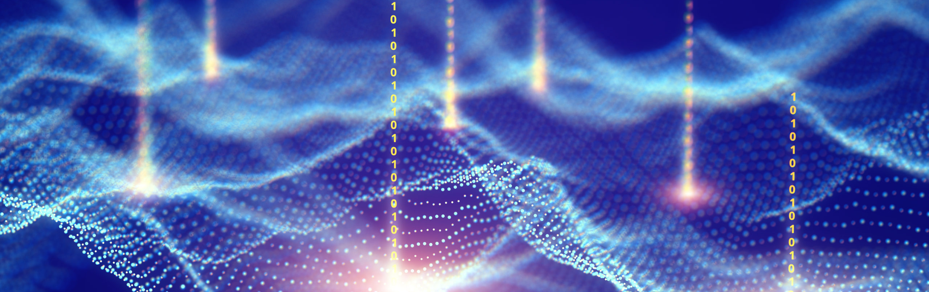
Emotion Extraction
4

Slide 5
Why emotion extraction is important?
In interpersonal relationships, recognition of human emotions is critical.
Emotions are expressed through voice, hand and body movements, and facial expressions.
As a result, extracting and comprehending emotion is critical in the interplay between human and machine communication.

Slide 6

Methods

Slide 7
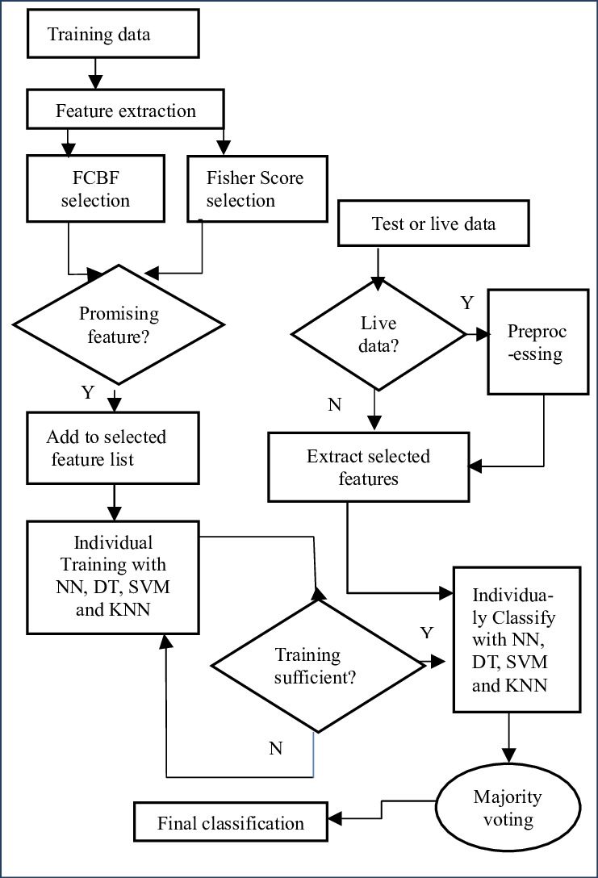
Methodology diagram

Slide 8
Used models
sigmoid logistic regression
Naive Bayes
random forest
Extreme Gradient Boosting

Slide 9
Used models
K-nearest neighbor
Decision Tree
Support vector classifier

Slide 10
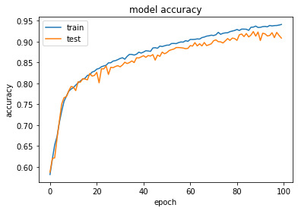
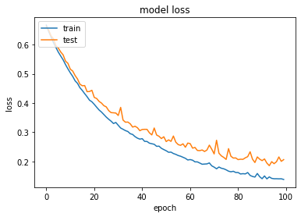
Results
Logistic regression:
Emotion extraction with EEG with accuracy: 94%

Slide 11
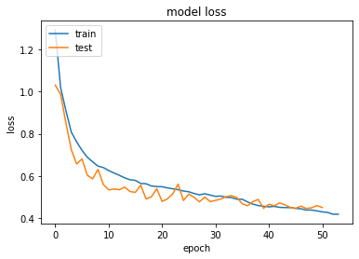
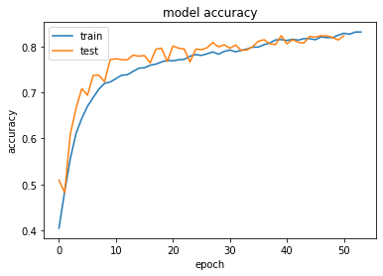
Results
DCNN:
Face recognition with Accuracy : 82%

Slide 12
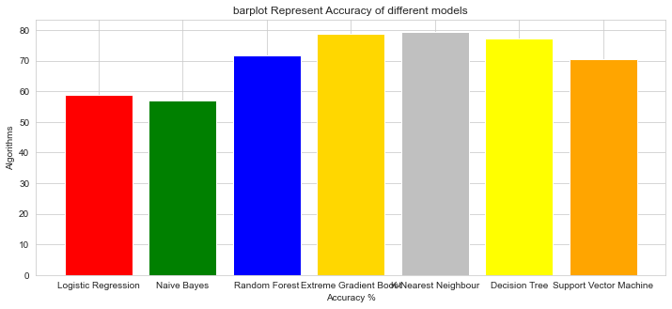
-Bert model with accuracy : 92%
-k-neighbors classifier model with
accuracy : 85%
-stacking CV classifier model with
accuracy : 80%
-decision tree classifier model with accuracy : 76%
-Extreme gradient boots model with accuracy : 75%
-Random forest model with accuracy: 68%
-support vector classifier model with accuracy : 65%
-logistic regression model with accuracy:58%
-Naive bayes model with accuracy: 55.5%

Slide 13
Applications
Detect if the students confused and stress or not using EEG.
reading frowns, smiles, and other expressions on faces, namely artificial intelligence to predict "attitudes and actions based on facial expressions.
integrating its face analytics and emotion recognition software; as well as with video content creators to help them measure the perceived effectiveness of their short and long form video creative

Slide 14
Conclusion
We used 8 models to extract, analyze and predict emotions through various signals.
EEG is the highest accuracy by 94%.
EEG signals will be the easiest to extract emotion from then facial expressions.
The least accuracy was the voice, and we convert it to text to get higher accuracy.
audio signals will take some time to develop and extract accurate results from.

Slide 15

Thank you
Any Questions?

